Slide 1

Farmer’s Field App
Presented by Md. Monir Ahammod 16CSE061 Kanon Chakma 16CSE0 Ekramul Islam 16CSE062 Rashedul Hasan 16CSE063 Anil Kamati 16CSE060 CSE,BSMRSTU |  | Supervised by Sakifa Akter Lecturer, Department of Computer Science and Engineering BSMRSTU
Computer Science and Engineering

Slide 2
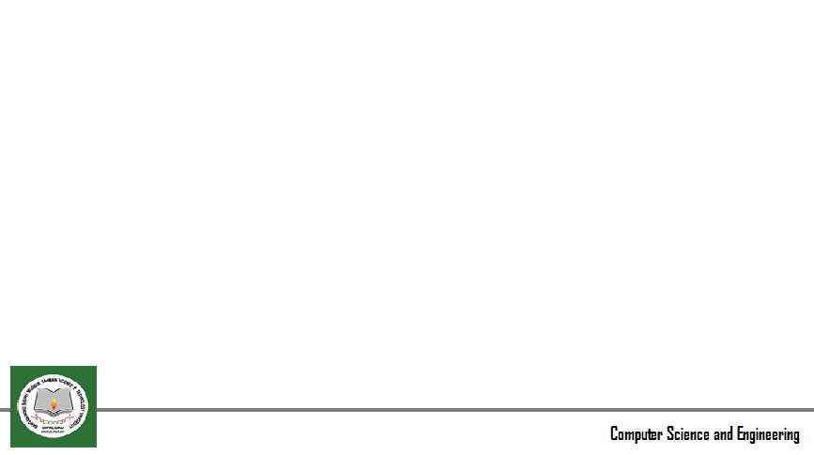
Contents
Introduction
Motivation
Objective
Methodology
Implementation
Conclusion & Future work
References

Slide 3
Introduction
‘ Farmer’s Field ‘ is a digital system of plants problem identification .
It is a digital attempt to quickly and effectively solve many problems related to farming.
It is designed with so many pictures so that farmer’s can identify problem by seeing pictures.
It has been made to rationalize the problems of crop-related problems. So the farmer can easily identify his problem.

Slide 4
Motivation
Here, the farmer himself can identify his problem by clicking here and clicking on the picture will solve the problem. Here are the problems that are caused by field crops, vegetables, fruits and other plant diseases, pests, insect deficiencies or other causes.
The problems and their solutions have been added. Each picture has multiple pictures and at least one represented picture

Slide 5
Goal (objectives)
The objective of this application is to wider reach and easy accessibility of crop information and service among farmers in Bangladesh.
Much of Bangladesh's economy is dependent on crop production. Crop production can be reduced due to various diseases caused by pests.
In the present era of science and technology, many people in rural Bengal have Android phones..
In this case, they will be able to easily know the signs and remedies of common crop diseases and can take timely measures accordingly if they install this app.

Slide 6
Tools
Android Studio Software
Photoshop Software
Firebase
UI/Ux designing Software
LANGUAGE
Java language

Slide 7
Features
Each problem has a picture attached so that the farmers can confirm the problem even after seeing the picture.
Home page.
Crops page
Query page
Picture with reading text

Slide 8


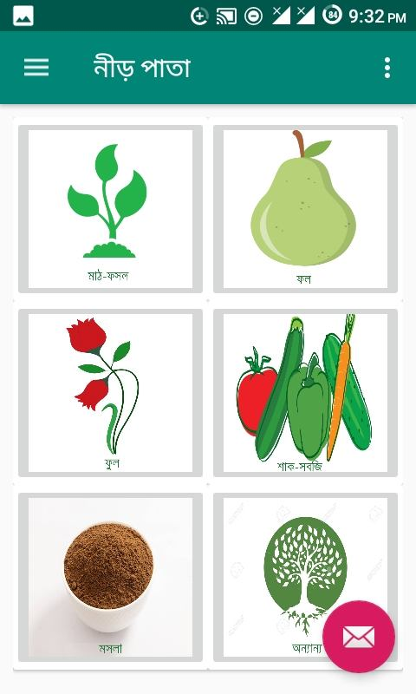
Features(Cont..)
Flow chart
Home page

Slide 9
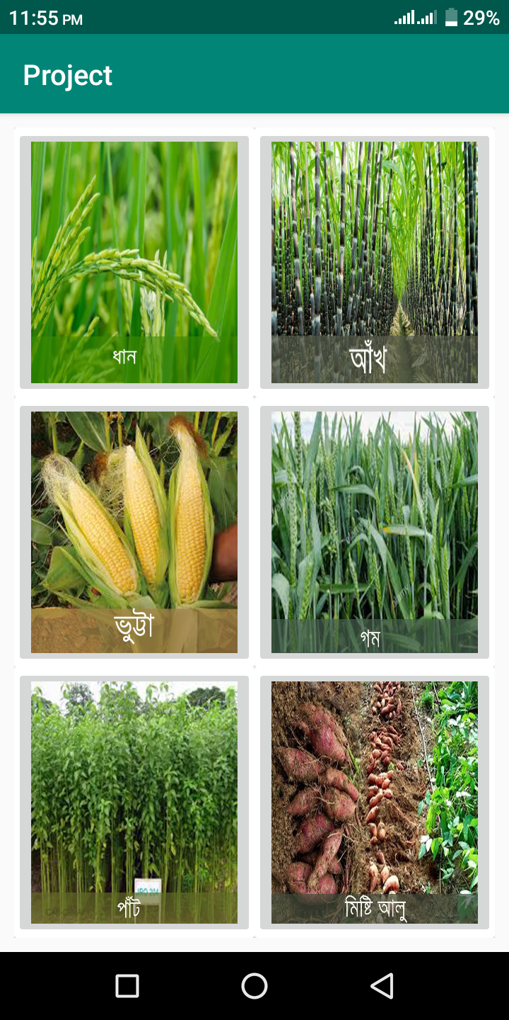
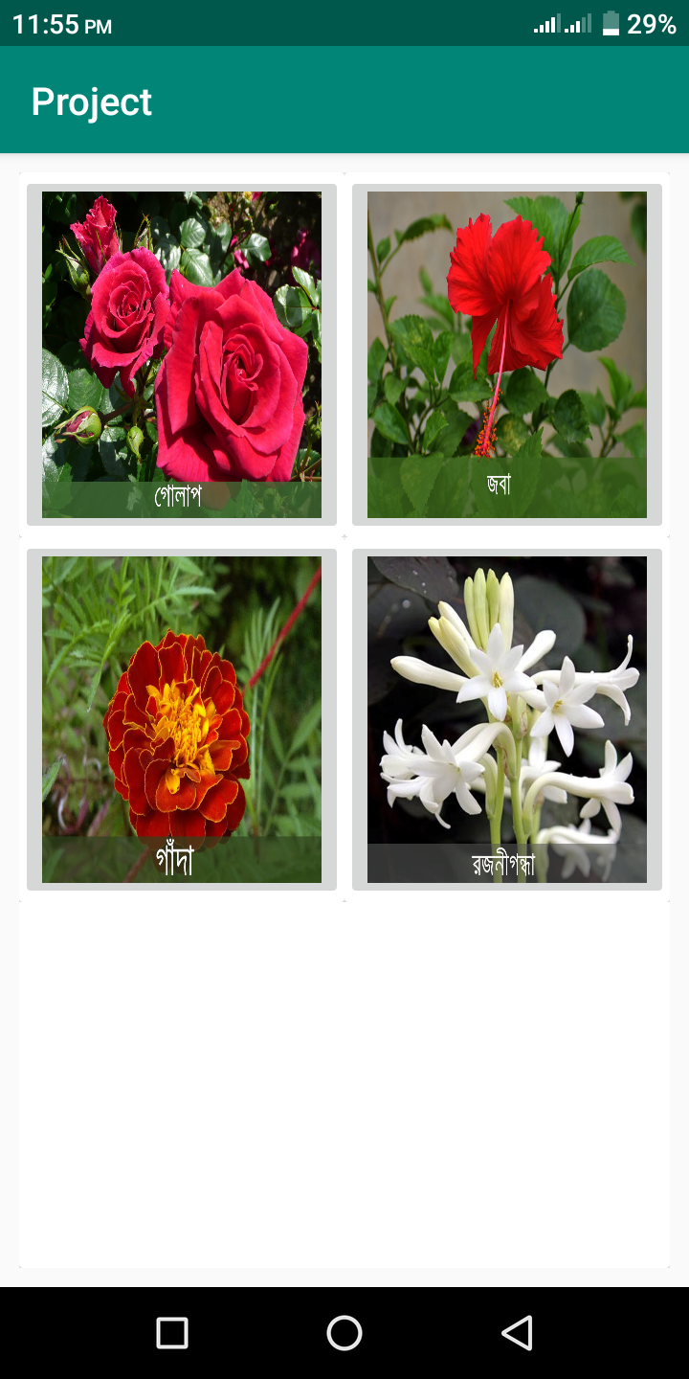
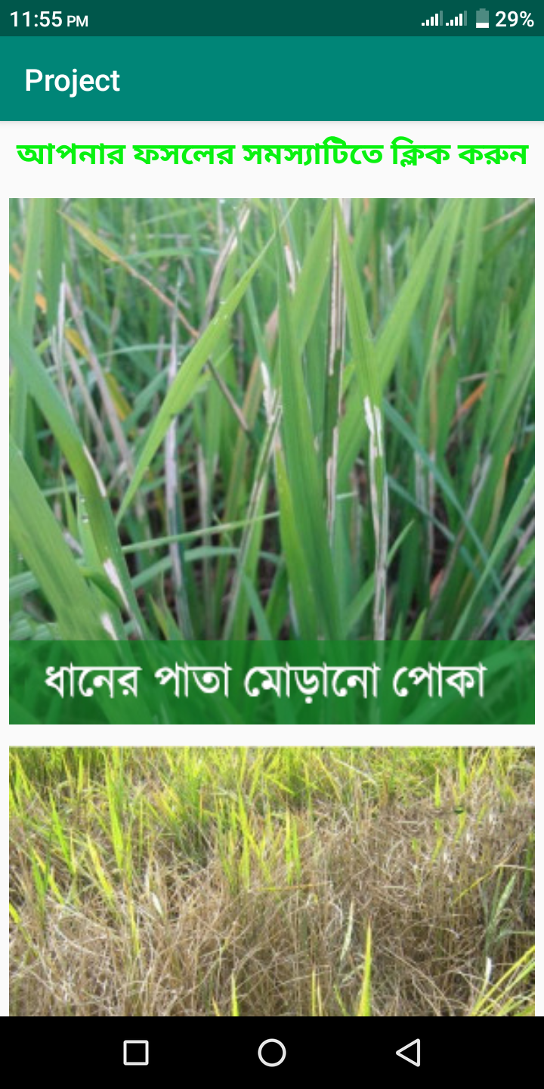
Features(Cont..)
Flow chart
Crops page

Slide 10
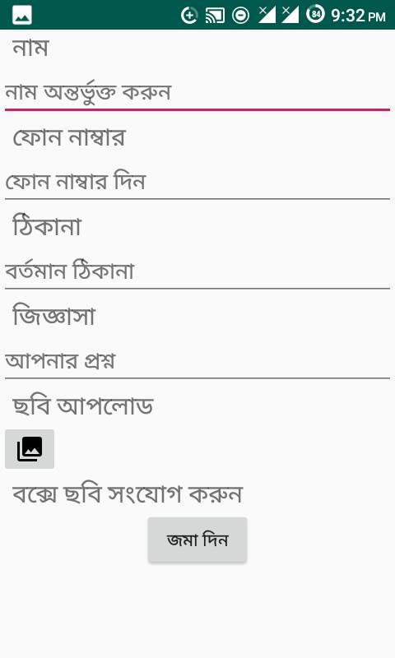
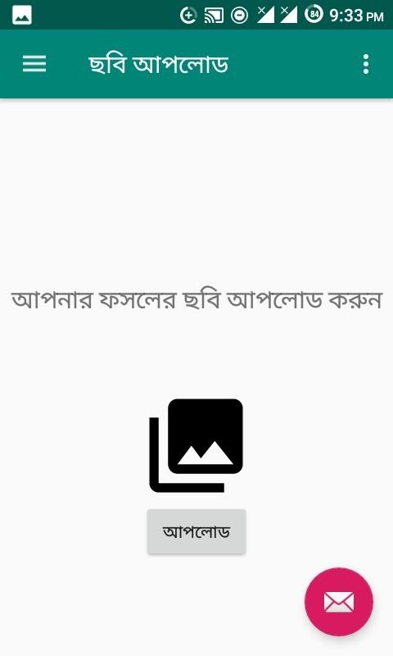
Features(Cont..)
Flow chart
Query Page

Slide 11
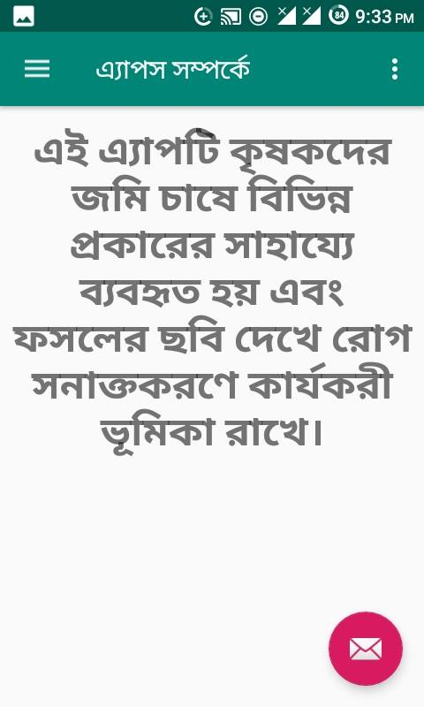
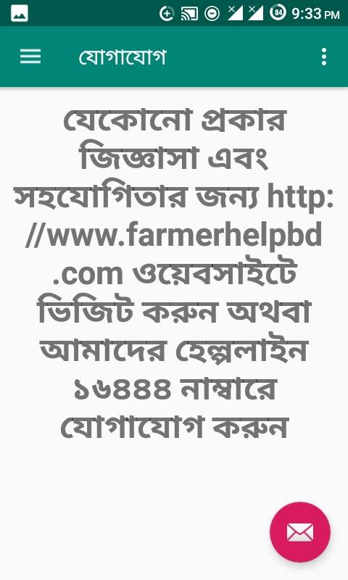
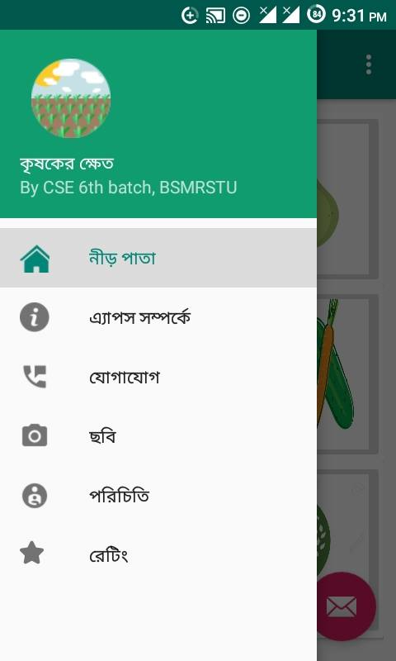
Features(Cont..)
Flow chart
Navigation bar

Slide 12
Implementation
First In Android Studio we design
Names and symptoms of diseases of major crops of Bangladesh are accurately described from reliable
Each problem has a picture attached so that the farmers can confirm the problem even after seeing the picture.
The solution to each problem is clearly written.
Environmentally friendly
Farmer-friendly

Slide 13
Conclusion
By using this app, our farmer can produce a huge crops as well as they fulfill their demand. But before they did not produce whatever they wanted.
Because that time, they did not know what type of diseases had occured as well as what type of step they could take against that diseases.
But now a days , our farmer easily find out the diseases and they would take action against these.
After all ,by using this app our farmer would gather much knowledge about farming.

Slide 14
Future work
In future we will add ‘image processing’ in these app.
Add more information in future such type of field crops
User interface will more efficiently.
User can Connect ‘Agriculture Officer’ more easily.

Slide 15
Thanks All

